Slide 1

*insert screenshot: first 3 rows of Learn.Share.Remix. event calendar (not TamTamy calendar)
*put “today” sticker on your event

Slide 2


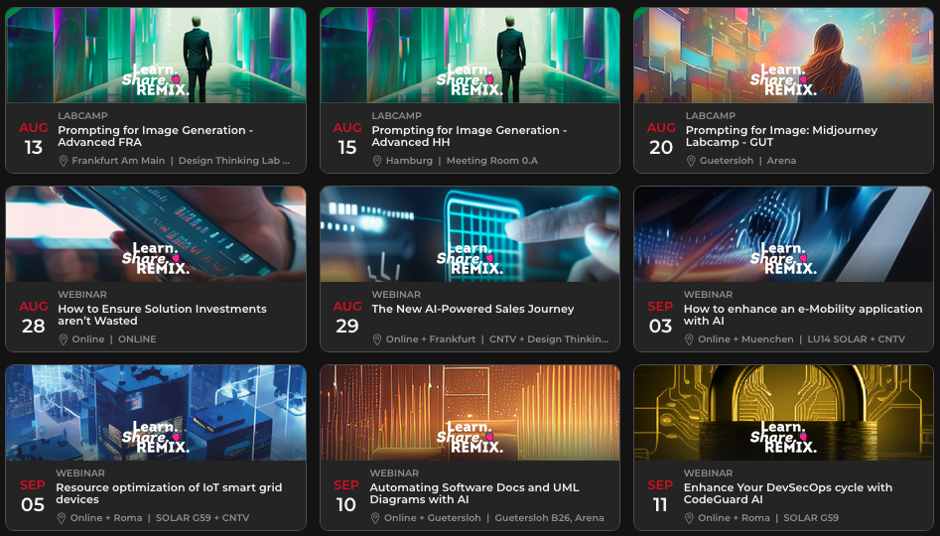
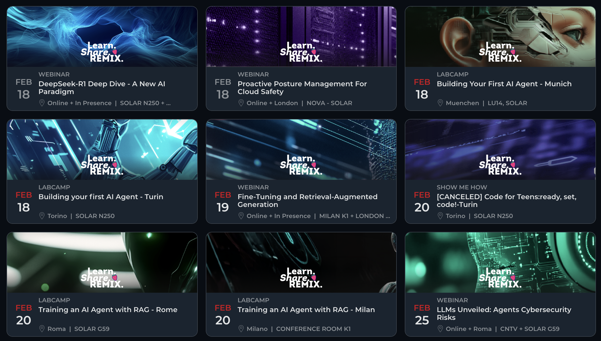

NEXT EVENTS
*insert screenshot: first 3 rows of Learn.Share.Remix. event calendar (not TamTamy calendar)
*put “today” sticker on your event

Slide 3
Labcamp 1 – BuiLding YOUR first ai agent
Ana-Maria, Lacatusu | Machine Learning Engineer @ Roboverse Reply

Slide 4

Who Am I?
Background & Education
Studied Informatics (B.Sc. & M.Sc.) at TUM, specializing in Machine Learning and Computer Vision
Professional Experience
Machine Learning Engineer at Roboverse Reply (since April 2024), integrating ML solutions for robotics
Over two years of experience as a Machine Learning researcher (Student and Full-time)
Research & Interests
Active member of the GenAI Community of Practice (COP), researching Visual Large Language Models (VLMs)
Why I’m Here Today
Excited to share insights on building AI agents
Looking forward to interactive discussions and hands-on experimentation
Ana-Maria Lacatusu a.lacatusu@reply.de

Slide 5
Meeting agenda
Building your first Ai agent
Introduction: What is a AI Agent?
Developer Tools
Hands-On
Prompting Techniques
Notes:
Remove short bio, put directly after title slide
Insert name under picture

Slide 6



Materials
This tutorial contains Jupyter notebooks. Please have VSCode installed and a running kernel with Python 3.11.9
Github Repository
Install Python version 3.11.9
Ubuntu
Install Python version 3.11.9
Windows/Mac

Slide 7
Introduction

Slide 8

What is AI Agent?
Key Features
An application that attempts to achieve a goal by observing the world and acting upon it using the tools at its disposal
Agents are autonomous and can act independently of human intervention when provided with goals to achieve
Agents can be proactive in reaching the goal. They can reason about what should be done next

Slide 9
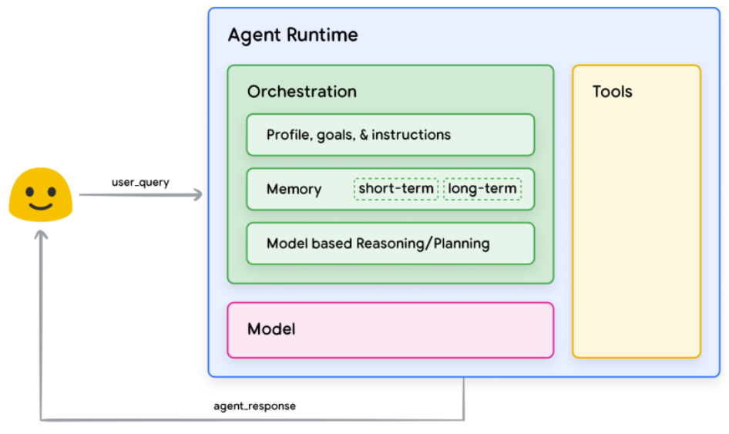
AI Agent Components
Components are usually:
Model: A Language Model
Tools: Extensions, Functions, and Data Stores
Orchestration Layer: Internal reasoning of the agent
Notes:
🔷️ Agents are AI on steroids: They go beyond basic models by using tools, making plans, and taking actions—more like humans solving problems. 🔷️ It’s all about the setup: To work, agents need three things: a smart model for decisions, tools to interact with the real world, and a system to manage how they plan and act. 🔷️ Tools make all the difference: APIs, databases, and real-time data give agents superpowers to move beyond just answering questions—they can actually do things. 🔷️ Building agents is getting easier: Platforms like LangChain and Vertex AI make it simple to create and deploy agents, even for complex tasks.
🔷️ There’s still work to do: Big challenges like making agents easy to use, interoperable, and privacy-friendly need solving before they truly take off.

Slide 10
Models vs Agents
Models | Agents
Knowledge is limited to their training data | Knowledge is extended via the external systems
Single inference | Session history
No tools | Tools are available
Notes:
Models:
Knowledge is limited to what is available in their training data
Agents:
Extended knowledge via external systems aka tools
Models:
Only inferencing user query. There is no session history.
Agents:
You have a session history

Slide 11

Examples of AI Agents
Reflex-based Agents
e.g. Thermostat
Model-based Agents
e.g. Self driving car
Goal-based Agents
e.g. Personal Fitness App
Task-based Agents
e.g. E-commerce agents
Notes:
Model based: The internal model allows the agent to understand how the environment evolves and how its actions will impact future states. By considering both current and past perceptions, model-based agents can handle more dynamic and complex environments.
Goal based:
Goal-based agents not only perceive the environment and maintain an internal state, but they also operate with specific goals in mind.
A goal-based agent evaluates different possible actions and selects the one that brings it closer to achieving its goal. These agents may require planning algorithms to map out actions over time to achieve long-term objectives.
Task based:
Designed to perform specific, well-defined tasks based on user instructions or inputs.
Scope: Narrow and specific.
Focus: Completing individual tasks efficiently and accurately.
Predefined workflows or logic for handling tasks.
Limited decision-making capabilities; follows structured paths.
Often rule-based.

Slide 12
Developer Tools Short overview

Slide 13

What is langchain?
Definition:
LangChain is a powerful framework for building applications that use large language models (LLMs) in combination with other tools and data sources
Core Idea:
It orchestrates LLMs, APIs, and memory to create intelligent and interactive applications
Completely Free to Use!

Slide 14
Why use langchain?
Supports Memory
Integrations
Focus on Development
Simplifies Complex Workflows
Notes:
Simplifies Complex Workflows: Easily chain prompts, models, and external tools.
Supports Memory: Build stateful agents that retain context.
Integrations: Works with APIs, databases, and external tools like Python scripts and vector databases.
Focus on Development: Write less boilerplate and more logic.

Slide 15
Key components Langchain
Chains
Agents
Memory
Tools
Embeddings
Notes:
Chains: Combine multiple steps or tasks into a pipeline.
Agents: Dynamically decide what action to take using LLMs (e.g., query a database, call APIs).
Memory: Store conversation history for stateful interactions.
Tools: Plugins for APIs, search engines, and vector databases.
Embeddings: Enable semantic search with vector databases.
These are sequences of steps or tasks that are combined into a pipeline. Each step in a chain can perform a specific action, and the result of one step can be passed to the next. Chains allow you to create complex workflows by stringing together simpler tasks. This mirrors the agentic idea in the text, where models think ahead and take actions step-by-step.
Example: prompt | model | output-parser
Embeddings enable semantic search by converting text (or other data types) into vectors, allowing for more nuanced search and retrieval based on meaning rather than exact keywords. This helps build intelligent systems that understand context, improving the decision-making process of agents and enhancing their ability to interact with diverse data sources.

Slide 16
Pros and Cons
Pros:
Rapid Prototyping
Modular Design
Broad Integrations
Cons:
Performance Overhead
Learning Curve
Dependency on APIs
Notes:
Pros:
Rapid Prototyping: Simplifies development with ready-to-use components for LLMs and tools.
Modular Design: Flexible and customizable—use only the components you need.
Broad Integrations: Works with APIs, vector databases, and external tools (e.g., OpenAI, Pinecone).
Cons:
Performance Overhead: Added abstraction may introduce latency and debugging complexity.
Learning Curve: Beginners may struggle with understanding chains, agents, and tools.
Dependency on APIs: Requires external services (e.g., OpenAI), leading to cost and privacy concerns.

Slide 17

What is Langgraph?
Definition:
LangGraph is a framework for building language-based AI agents by structuring tasks as graph-like flows.
Strengths:
Visualizes and analyzes data connections.
Ideal for complex workflows with multiple stages.
Free and Enterprise Versions exist!
Notes:
Focus:
LangGraph: Mapping and understanding relationships in data.
LangChain: Focused on language processing.

Slide 18
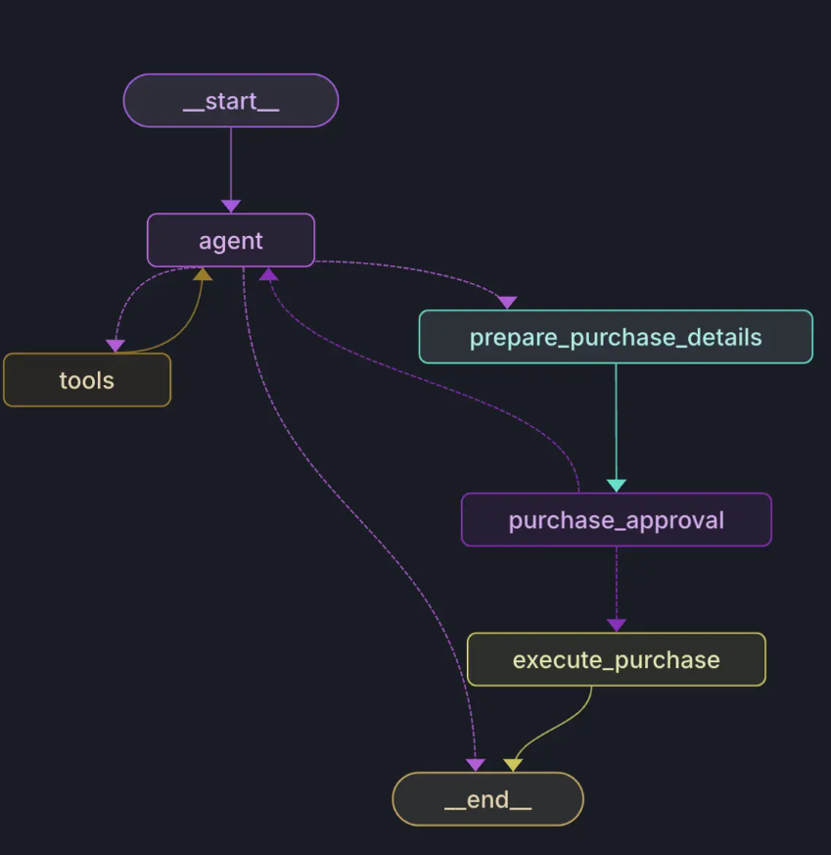
Why use langgraph?
Graph-Based Logic
Modular & Extensible
Reusability & Maintainability
Notes:
Graph-Based Logic:
Provides a visual, intuitive way to organize tasks and decisions in an agent.
Offers flexibility to model complex workflows with minimal coding.
Modular & Extensible:
Integrates easily with different tools (APIs, databases, ML models).
Can be adapted to specific needs without building everything from scratch.
Reusability & Maintainability:
Agents are composed of reusable components, making them easy to extend or modify as requirements change.

Slide 19
Key components Langgraph
Nodes
Edges
Contexts
Conditions
External Integrations
Notes:
Nodes: Represent individual tasks or actions that the agent performs. Each node has an associated operation (e.g., query, calculation, decision).
Edges: Define the flow between nodes. They determine the sequence or conditions under which actions are executed.
Contexts: Hold data or variables that agents use during task execution (e.g., user preferences, external data).
Conditions: Specify the logic or rules that determine which path the agent takes between nodes. This enables the agent to make dynamic decisions based on context.
External Integrations: Ability to link to APIs, databases, or other services for real-time data fetching and processing.

Slide 20
Other Developer Tools To Consider
FlowiseAI – Low-Code, Drag and Drop UI, Fully open sourced
OpenAI Swarm – Multi-Agent, Not production ready, Fully open sourced
CrewAI – Multi-Agent, Very simplistic, Good for beginners, Free and Pro plan
LangSmith – LLM applications, Great debugging and performance monitoring tools, Free and Enterprise Version

Slide 21
Hands-ON TIME

Slide 22




Use Case: Marketing a Christmas Gift

Slide 23


Use Case: Marketing a Christmas Gift

Slide 24
Use Case: Marketing a Christmas Gift
Capabilities and Roles
Easy Interaction
Simple and intuitive communication
Notes:
Adaptable Roles
Supervisor:
Critically evaluate ideas
Suggest actionable improvements
Marketing Agent:
Craft compelling pitches
Store and organize creative ideas
Personal Assistant:
Assist with scheduling and organizational tasks
Propose meeting times and send emails to supervisors

Slide 25
Use Case: Marketing a Christmas Gift
Capabilities and Roles
Easy Interaction
Simple and intuitive communication
Sketch Understanding
Analyze and interpret visual ideas effectively
Notes:
Adaptable Roles
Supervisor:
Critically evaluate ideas
Suggest actionable improvements
Marketing Agent:
Craft compelling pitches
Store and organize creative ideas
Personal Assistant:
Assist with scheduling and organizational tasks
Propose meeting times and send emails to supervisors

Slide 26
Use Case: Marketing a Christmas Gift
Capabilities and Roles
Easy Interaction
Simple and intuitive communication
Sketch Understanding
Analyze and interpret visual ideas effectively
Adaptable Roles
Supervisor
Marketing Agent
Personal Assistant
Notes:
Adaptable Roles
Supervisor:
Critically evaluate ideas
Suggest actionable improvements
Marketing Agent:
Craft compelling pitches
Store and organize creative ideas
Personal Assistant:
Assist with scheduling and organizational tasks
Propose meeting times and send emails to supervisors

Slide 27

Tech Stack
Gemini 2.0 newly released reasoning model
Python
External Tools – Email and Calendar
Notes:
Over the last year, we have been investing in developing more agentic models, meaning they can understand more about the world around you, think multiple steps ahead, and take action on your behalf, with your supervision.
Today we’re excited to launch our next era of models built for this new agentic era: introducing Gemini 2.0, our most capable model yet. With new advances in multimodality — like native image and audio output — and native tool use, it will enable us to build new AI agents that bring us closer to our vision of a universal assistant.

Slide 28
Prompting Techniques

Slide 29
Role Prompting
Showcased in the demo: marketing agent, personal assistant, supervisor
The same agent can take different roles
This prompting style can increase the accuracy of the answers and, also, style it as if a person with a specific background or occupation is answering the questions

Slide 30
Chain Of thought
Using chain of thought helps the LLM take a logical and arithmetic approach.
Instead of outputting the answer immediately, the LLM uses smaller and easier steps to get to the answer.

Slide 31
Chain Of thought
Example
prompt = """
Question: 11 factories can make 22 cars per hour. How much time would it take 22 factories to make 88 cars?
Answer: A factory can make 22/11=2 cars per hour. 22 factories can make 22*2=44 cars per hour. Making 88 cars would take 88/44=2 hours. The answer is 2 hours.
Question: 5 people can create 5 donuts every 5 minutes. How much time would it take 25 people to make 100 donuts?
Answer:"""
answer =
Here’s how you solve the donut problem:
1. Find the individual production rate:
If 5 people make 5 donuts in 5 minutes, that means one person makes one donut in 5 minutes.
2. Calculate the total production rate:
With 25 people, and each person making one donut every 5 minutes, they would make 25 donuts every 5 minutes.
3. Determine the time to make 100 donuts:
Since they make 25 donuts every 5 minutes, it will take 4 sets of 5 minutes to make 100 donuts (100 donuts / 25 donuts per 5 minutes = 4 sets).
Answer: It would take 25 people 20 minutes (4 sets x 5 minutes per set) to make 100 donuts.

Slide 32
REACt Prompting
Combines retrieval of relevant information with step-by-step reasoning to enable the AI agent to better tackle complex tasks.
"REACT" stands for Reasoning + Acting
Notes:
"REACT" stands for Reasoning + Acting, emphasizing the dual process of:
Reasoning: Breaking down a problem into logical steps
Acting: Taking specific actions (e.g., querying a database, retrieving documents, or interacting with APIs) based on the reasoning process.

Slide 33
REACt Prompting
Example
answer =
Question: “I want to book a flight ...”
Thought: I should search for flights ...
Action: Flights Tool
Action Input: Flights from Munich to Zurich
Observation: The tool returns many options
Thought: I should present this to the user ...
Final Answer: Here are some flight options ...
prompt = """
I want to book a flight from Munich to Zurich
"""
Notes:
"REACT" stands for Reasoning + Acting, emphasizing the dual process of:
Reasoning: Breaking down a problem into logical steps
Acting: Taking specific actions (e.g., querying a database, retrieving documents, or interacting with APIs) based on the reasoning process.

Slide 34
Few-Shot Prompting
Some prompts may need a bit more information or require a specific output schema for the LLM to understand and accomplish the requested task
In such cases, providing example questions with answers to the model may greatly increase the quality of the response

Slide 35
Few-Shot Prompting
Example
answer =
Whale > Monkey > Goldfish
prompt = """
Sort the animals from biggest to smallest.
Question: Sort Tiger, Bear, Dog
Answer: Bear > Tiger > Dog
Question: Sort Cat, Elephant, Zebra
Answer: Elephant > Zebra > Cat
Question: Sort Whale, Goldfish, Monkey
Answer:"""

Slide 36
Debbuging TIME

Slide 37
Thank you
Ana-Maria, Lacatusu | Machine Learning Engineer @ Roboverse Reply
Email: a.lacatusu@reply.de

Slide 38


Ana-Maria, Lacatusu | Machine Learning Engineer @ Roboverse Reply
Email: a.lacatusu@reply.de

Slide 39



Slide 40



JOIN YOUR
LOCAL TEAMS
EVENT CHANNEL

